Slide 1
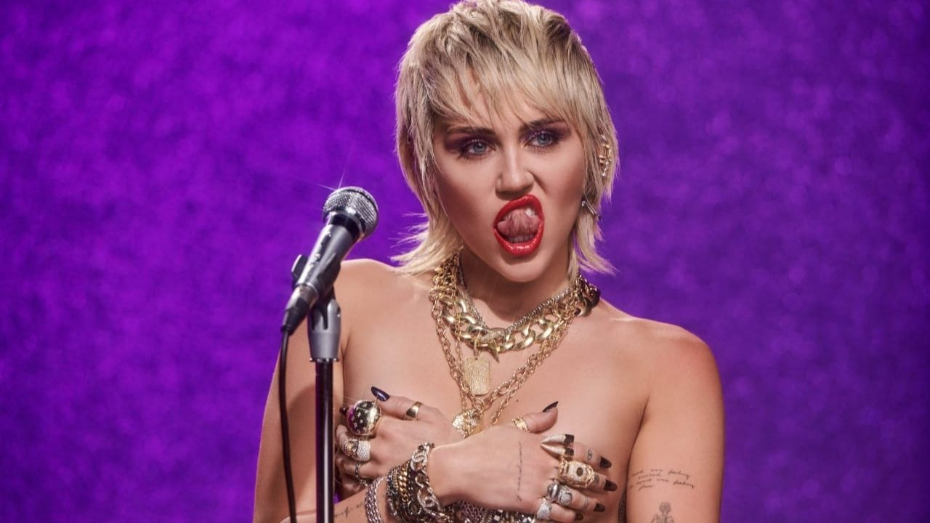
MIDNIGHT SKY MUSIC VIDEO
PRESENTATION PITCH BY SOPHIE LOCKE

Slide 2
Miley cyrus research
Miley ray Cyrus is an American singer, songwriter, and actress. She is well known for her distinctive raspy voice, and her music spans a range of styles, from pop and country pop to hip hop, experimental and rock. At the start of her career, she mostlty started out singing country and pop and then embraces her rock and roll heart in her latest album 'plastic hearts'. The genre of music I planned on choosing was always going to be pop/rock, so I figured Mileys recent songs were a good fit.

Slide 3
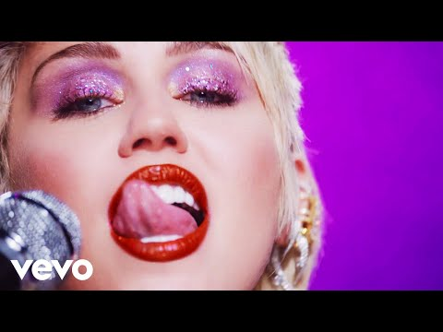
‘MIDNIGHT SKY’ SONG
The song I chose to do for my final major project music video is ‘Midnight sky’ by Miley Cyrus. The genre of this song is pop/rock. In my opinion this song is great and also very catchy which is something I took into consideration when choosing it, as I wanted to enjoy creating it as well as others enjoy watching it.
In contrast to my last music video, I wanted this one to be quite fun and upbeat and colourful instead of dark and cryptic. This being said, I wanted to pick a song that matched the vibe I was going for. I had quite a few song choices at first but I felt like this was the best due to its elements of rock and it also being very modern.

Slide 4
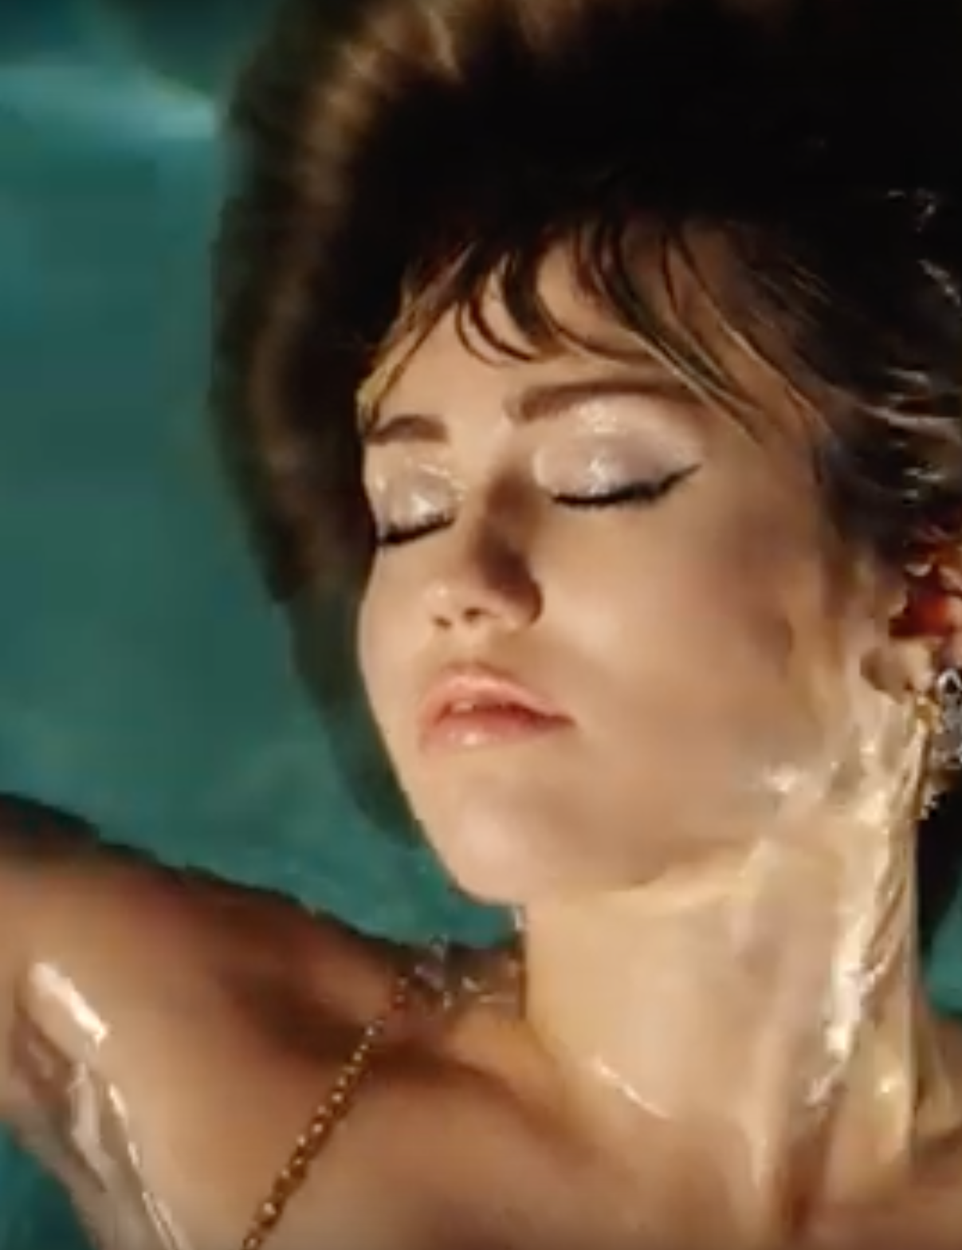
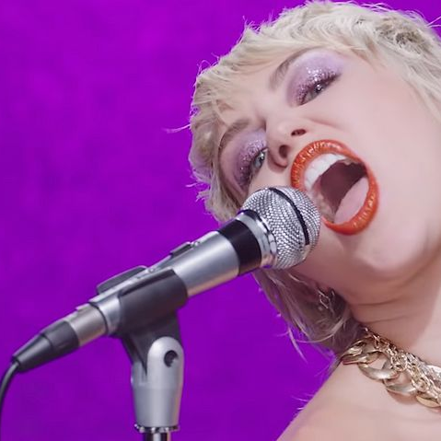

Music video Idea
The music video to midnight sky has given me a lot of inspiration as to things I would like to include in mine. I think the colours in the video really stand out which is one thing I like. This video is only a performance video as Miley performs her song whilst in different set locations. The locations are all very vibrant and wild which sets it apart from normal music videos. For example she can be seen in a ball pit, a room filled with glitterballs and colourful animals.
The song suggests that Miley is letting go of her past relationships and her new free spirit. The storyline for my video is going to be a teenage girl waking up hungover from the night before. She is looking rough and receives a text message from her boyfriend saying they are over. She is confused but then feels a relief when she comes to her senses that she is better off without him. She will then be having lots of fun and have freedom as the lyrics explain and the song goes on.

Slide 5
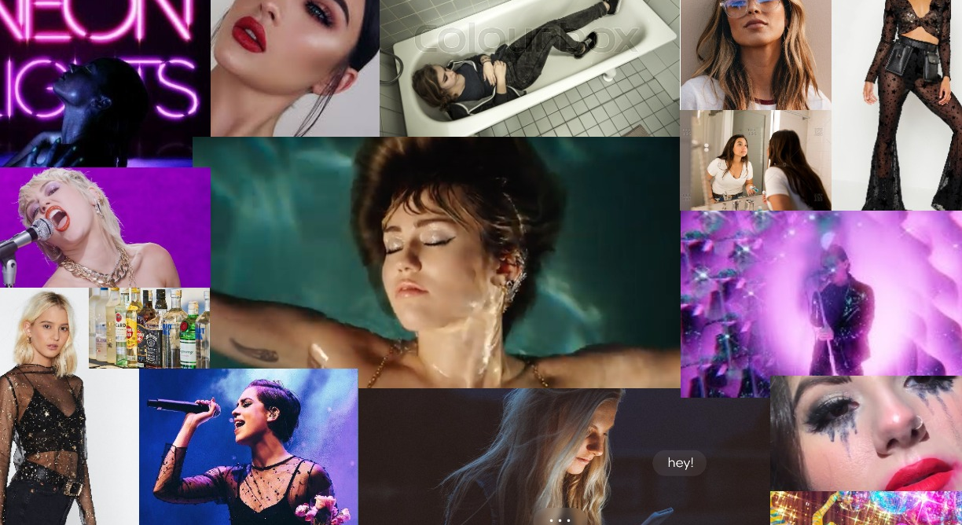

Slide 6
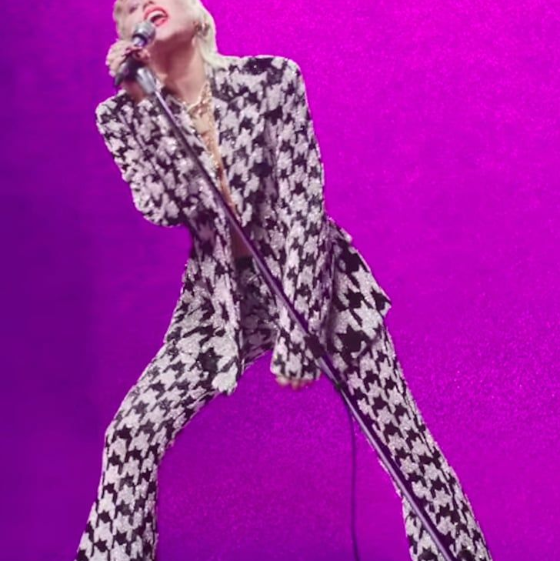
Music video style
I want my video to be a mixture of narrative and performance. The storyline will mostly be featured at the start and then the actor will be performing the song throughout. I would like my actor to sing all the lyrics the whole way through so that I can match it up to the song when editing.
I want Amy to wear 'rockstar' style clothes that are quite extravagent and stand out to the viewer. I would like Amy to have a full face of makeup on with red lipstick and black eyeliner to make her look older and more mature.

Slide 7

Production research
I am going to be using my sister as the actor in this video and I have spoken to her about it and she has given permission. I think it is the best idea to have Amy as my actor as we live in the same house and will have more time to film with her rather than people at college.
In my previous projects I have used my phone which did work well apart from getting the footage onto the computer which was hard. I will not be using a camera just because I found the quality on my phone came out a lot clearer and I could make my video be in 4k. The only downside is the fact I will have to download all my footage onto the computer and last time it took hours as I am not able to use an Sd card. I will not be recording any sound, so I will not need any sound equipment and I also own a tripod in case I need to use it

Slide 8

Final thoughts
In conclusion, I think that my music video has the potential to turn out well due to having experience filming one before and knowing what works well. I have done a lot of planning on the look and style of the video which will help me out a lot when it comes to filming. I know exactly what I want the storyline to be and Im looking forward to get started.

